Slide 1
Inventory Management
Chapter 9

Slide 2
Inventory at WAL⁻MART
Making sure the shelves are stocked with tens of thousands of items at their 5,379 stores in 10 countries is no small matter for inventory managers at Wal-Mart.
Knowing what is in stock, in what quantity, and where it is being held, is critical to effective inventory management.
With inventories in excess of $29 billion, Wal-Mart is aware of the benefits from improved inventory management.
They know that effective inventory management must include the entire supply chain.
The firm is implementing radio frequency identification (RFID) technology in its supply chain.
When passed within 15’ of a reader, the chip activates, and its unique product identifier code is transmitted to an inventory control system.

Slide 3
Inventory Management
Inventory management is the planning and controlling of inventories in order to meet the competitive priorities of the organization.
  Effective inventory management is essential for realizing the full potential of any value chain.
Inventory management requires information about expected demands, amounts on hand and amounts on order for every item stocked at all locations.
  The appropriate timing and size of the reorder quantities must also be determined.

Slide 4
Inventory Basics
Inventory is created when the receipt of materials, parts, or finished goods exceeds their disbursement.
Inventory is depleted when their disbursement exceeds their receipt.
An inventory manager’s job is to balance the advantages and disadvantages of both low and high inventories.
  Both have associated cost characteristics.

Slide 5
Pressures for
Low Inventories
Inventory holding cost is the sum of the cost of capital and the variable costs of keeping items on hand, such as storage and handling, taxes, insurance, and shrinkage.
  Cost of Capital is the opportunity cost of investing in an asset relative to the expected return on assets of similar risk.
  Storage and Handling arise from moving in and out of a storage facility plus the rental cost and/or opportunity cost of that space.
  Taxes, Insurance, and Shrinkage: More taxes are paid and insurance costs are higher if end-of-the-year inventories are high. Shrinkage comes from theft, obsolescence and deterioration.

Slide 6
Pressures for
High Inventories
Customer Service: Reduces the potential for stockouts and backorders.
Ordering Cost: The cost of preparing a purchase order for a supplier or a production order for the shop.
Setup Cost: The cost involved in changing over a machine to produce a different item.
Labor and Equipment: Creating more inventory can increase workforce productivity and facility utilization.
Transportation Costs: Costs can be reduced.
Quantity Discount: A drop in the price per unit when an order is sufficiently large.

Slide 7
Types of Inventory
Cycle Inventory: The portion of total inventory that varies directly with lot size (Q).
  Average cycle inventory =
  Lot Sizing: The determination of how frequently and in what quantity to order inventory.
Safety Stock Inventory: Surplus inventory that a company holds to protect against uncertainties in demand, lead time and supply changes.
Q
2

Slide 8
Types of Inventory
Anticipation Inventory is used to absorb uneven rates of demand or supply, which businesses often face.
Pipeline Inventory: Inventory moving from point to point in the materials flow system.
D_{L} is the average demand for the item per period (d) times the number of periods in the item’s lead time (L).
Pipeline inventory = D_{L} = dL

Slide 9
Estimating Inventory Levels
Example 12.1
A plant makes monthly shipments of electric drills to a wholesaler in average lot sizes of 280 drills. The wholesaler’s average demand is 70 drills a week. Lead time is 3 weeks. The wholesaler must pay for the inventory from the moment the plant makes a shipment. If the wholesaler is willing to increase its purchase quantity to 350 units, the plant will guarantee a lead time of 2 weeks. What is the effect on cycle and pipeline inventories?
Q
2
2802
drills
Average cycle inventory = = = 140
Pipeline inventory = D_{L} = dL = 70(3) = 210
drills
Under new proposal, the average lot size becomes 350 and lead time of 2 weeks. Average demand remains at 70 drills a week.
Q
2
3502
drills
Average cycle inventory = = = 175
Pipeline inventory = D_{L} = dL = 70(2) = 140
drills
© 2007 Pearson Education

Slide 10
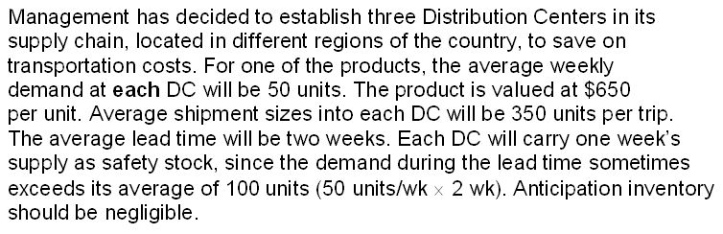
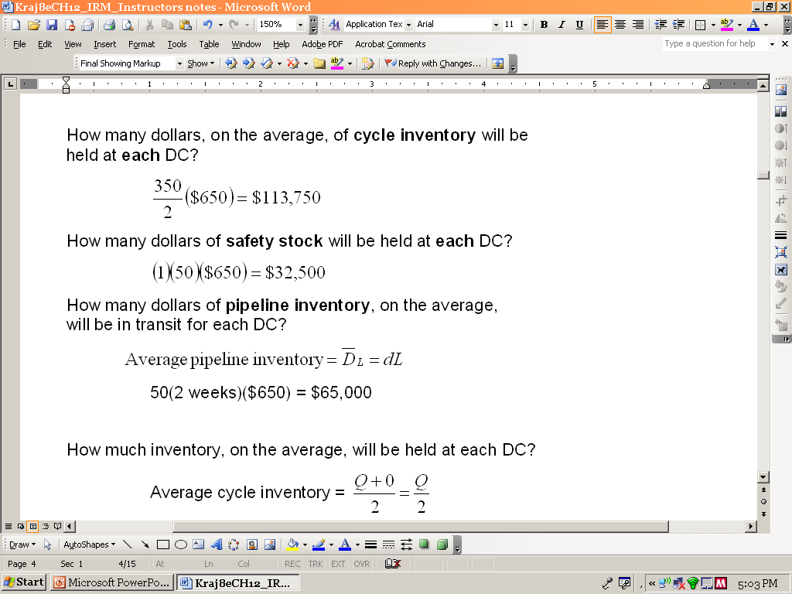
Application 12.1

Slide 11
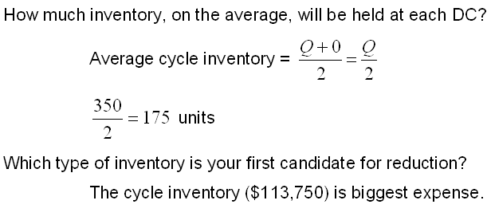
Application 12.1 continued

Slide 12
Reducing
Cycle Inventory
The primary tactic (lever) for reducing cycle inventory is to reduce lot size.
This can be devastating if other changes are not made, so two secondary levers can be used:
  Streamline the methods for placing orders and making setups in order to reduce ordering and setup costs and allow Q to be reduced.
  Increase repeatability in order to eliminate the need for changeovers.
  Repeatability is the degree to which the same work can be done again.

Slide 13
Reducing
Safety Stock Inventory
The primary lever to reduce safety stock inventory is to place orders closer to the time they must be received. However, this approach can lead to unacceptable customer service.
Four secondary levers can be used in this case:
  Improve demand forecasts so that fewer surprises come from customers.
  Cut the lead times of purchased or produced items to reduce demand uncertainty.
  Reduce supply uncertainties. Share production plans with suppliers. Surprises from unexpected scrap or rework can be reduced by improving manufacturing processes. Preventive maintenance can minimize unexpected downtime caused by equipment failure.
  Rely more on equipment and labor buffers, such as capacity cushions and cross-trained workers.

Slide 14
Reducing
Anticipation Inventory
The primary lever to reduce anticipation inventory is simply to match demand rate with production rate.
Secondary levers can be used to even out customer demand in one of the following ways:
  Add new products with different demand cycles so that a peak in the demand for one product compensates for the seasonal low for another.
  Provide off-season promotional campaigns.
  Offer seasonal pricing plans.

Slide 15
Reducing
Pipeline Inventory
The primary lever for reducing pipeline inventory is to reduce the lead time.
Two secondary levers can help managers cut lead times:
  Find more responsive suppliers and select new carriers for shipments between stocking locations or improve materials handling within the plant.
  Decrease lot size, Q, at least in those cases where the lead time depends on the lot size. Smaller jobs generally require less time to complete.

Slide 16
Identifying Critical Inventory Items
Thousands of items are held in inventory by a typical organization, but only a small % of them deserves management’s closest attention and tightest control.
ABC analysis: The process of dividing items into three classes, according to their dollar usage, so that managers can focus on items that have the highest dollar value.

Slide 17
ABC Analysis
100 —
90 —
80 —
70 —
60 —
50 —
40 —
30 —
20 —
10 —
0 —
Class C
Class B
Class A
Percentage of dollar value
10
20
30
40
50
60
70
80
90
100
Percentage of items

Slide 18
Economic Order Quantity
Economic Order Quantity (EOQ) is the lot size that minimizes total annual inventory holding and ordering costs.
Assumptions of EOQ
  The demand rate is constant and known with certainty.
  There are no constraints on lot size.
  The only relevant costs are holding costs and ordering/setup costs.
  Decisions for items can be made independently of other items.
  Lead time is constant and known with certainty.

Slide 19
Cycle-Inventory Levels
Receive order
Inventory depletion (demand rate)
Q
On-hand inventory (units)
Average
cycle
inventory
Q
—
2
1 cycle
Time

Slide 20
Total Annual
Cycle-Inventory Costs
Q = lot size; C = total annual cycle-inventory cost
H = holding cost per unit; D = annual demand
S = ordering or setup costs per lot
Q
2
D
Q
Total cost = (H) + (S)
Annual cost (dollars)
Q
2
Holding cost = (H)
D
Q
Ordering cost = (S)
Lot Size (Q)

Slide 21
Costing out a Lot Sizing Policy Example 12.2
Museum of Natural History Gift Shop:
Bird feeder sales are 18 units per week, and the supplier charges $60 per unit. The cost of placing an order (S) with the supplier is $45.
Annual holding cost (H) is 25% of a feeder’s value, based on operations 52 weeks per year.
Management chose a 390-unit lot size (Q) so that new orders could be placed less frequently.
What is the annual cycle-inventory cost (C) of the current policy of using a 390-unit lot size?

Slide 22
Costing out a Lot Sizing Policy Example 12.2
Museum of Natural History Gift Shop:
What is the annual cycle-inventory cost (C) of the current policy of using a 390-unit lot size?
D = (18 /week)(52 weeks) = 936 units H = 0.25 ($60/unit) = $15
Q
2
D
Q
390
2
936
390
C = (H) + (S) = (15) + (45)
C = $2925 + $108 = $3033

Slide 23
Lot Sizing at the Museum of Natural History Gift Shop
D = 936 units; H = $15; S = $45; Q = 390 units; C = $3033
Q = 468 units; C = ?
Would a lot size of 468 be better?
Q
2
D
Q
468
2
936
468
C = (H) + (S) = (15) + (45)
C = $3510 + $90 = $3600
Q = 468 is a more expensive option.
The best lot size (EOQ) is the lowest point on the total annual cost curve!

Slide 24
Lot Sizing at the Museum of Natural History Gift Shop
3000 —
2000 —
1000 —
0 —
Current
cost
Total cost
Annual cost (dollars)
Holding cost
Lowest
cost
Ordering cost
| | | | | | | |
50 100 150 200 250 300 350 400
Best Q (EOQ)
Current
Q
Lot Size (Q)

Slide 25
Computing the EOQ
Example 12.3
Bird Feeders:
D = annual demand
S = ordering or setup costs per lot
H = holding costs per unit
2DS
H
EOQ =
D = 936 units
H = $15
S = $45
2(936)45
15
EOQ =
= 74.94 or 75 units
Q
2
D
Q
75
2
936
75
C = (H) + (S)
C = (15) + (45)
C = $1,124.10

Slide 26
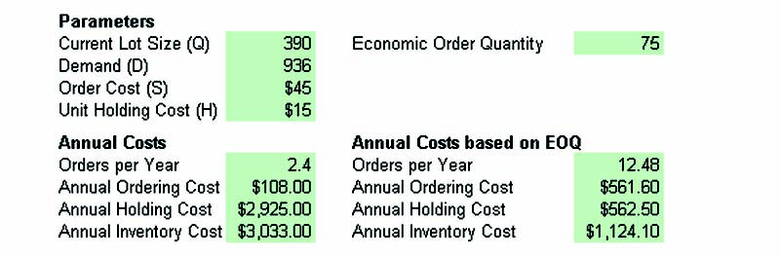
Computing EOQ using the Excel Solver

Slide 27
Time Between Orders
Time between orders (TBO) is the average elapsed time between receiving (or placing) replenishment orders of Q units for a particular lot size.
Example 12.3 continued:
For the birdfeeder example, using an EOQ of 75 units.
EOQ
D
TBO_{EOQ} =
EOQ
D
TBO_{EOQ} = = 75/936 = 0.080 year
TBO_{EOQ} = (75/936)(12) = 0.96 months
TBO_{EOQ} = (75/936)(52) = 4.17 weeks
TBO_{EOQ} = (75/936)(365) = 29.25 days

Slide 28
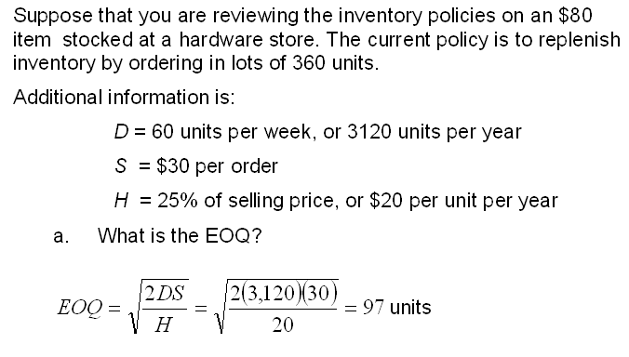
Application 12.2

Slide 29
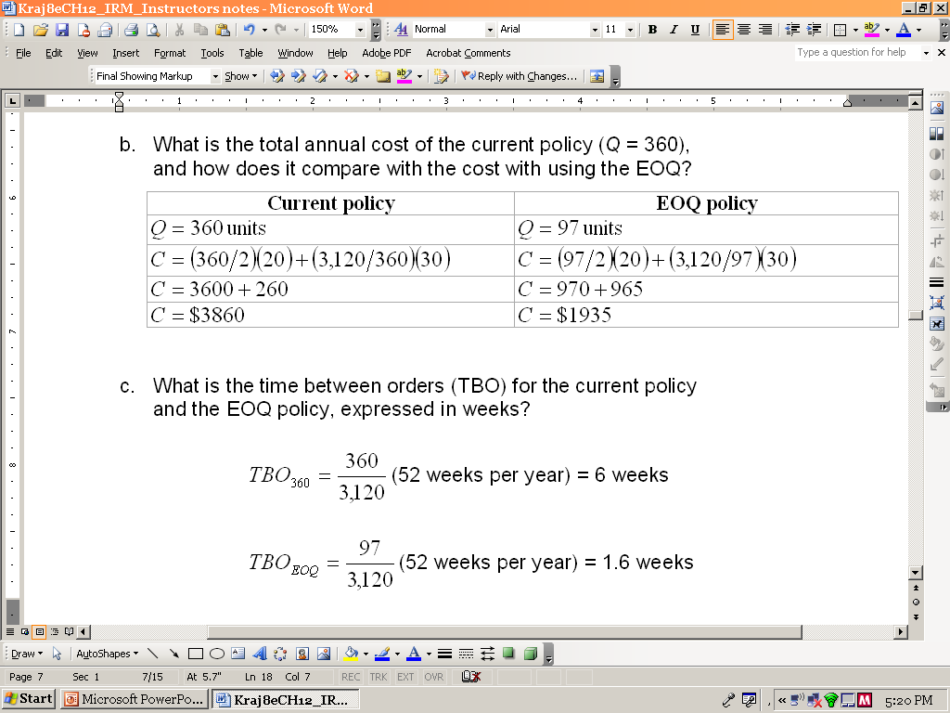
Application 12.2 continued

Slide 30
Understanding the
Effect of Changes
A Change in the Demand Rate (D): When demand rises, the lot size also rises, but more slowly than actual demand.
A Change in the Setup Costs (S): Increasing S increases the EOQ and, consequently, the average cycle inventory.
A Change in the Holding Costs (H): EOQ declines when H increases.
Errors in Estimating D, H, and S: Total cost is fairly insensitive to errors, even when the estimates are wrong by a large margin. The reasons are that errors tend to cancel each other out and that the square root reduces the effect of the error.

Slide 31
Inventory
Control Systems
Inventory control systems tell us how much to order and when to place the order.
  Independent demand items: Items for which demand is influenced by market conditions and is not related to the inventory decisions for any other item held in stock.
Continuous review (Q) systems (Reorder point systems ROP) are designed to track the remaining inventory of an item each time a withdrawal is made to determine whether it is time to reorder.
Periodic review (P) systems (Fixed Interval Reorder systems) in which an item’s inventory position is reviewed periodically rather than continuously.

Slide 32
Inventory
Control Systems
Inventory position (IP) is the measurement of an item’s ability to satisfy future demand.
IP = OH + SR – BO
Scheduled receipts (SR) or Open orders are orders that have been placed but have not yet been received.
Reorder point (R) is the predetermined minimum level that an inventory position must reach before a fixed order quantity Q of the item is ordered.

Slide 33
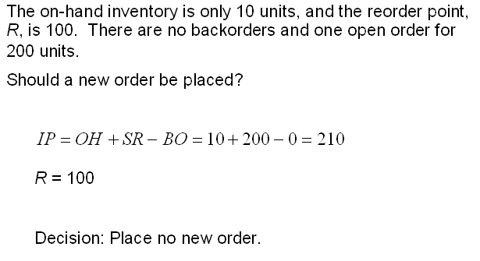
Application 12.3

Slide 34
Continuous Review
Q systems when demand & lead time are constant and certain.
IP
IP
IP
Order
received
Order
received
Order
received
Order
received
Q
Q
Q
On-hand inventory
OH
OH
OH
R
Order
placed
Order
placed
Order
placed
L
L
L
Time
TBO
TBO
TBO

Slide 35
Determining Whether to Place an Order
Example 12.4
Demand for chicken soup is always 25 cases a day and lead time is always 4 days. Chicken soup was just restocked, leaving an on-hand inventory of 10 cases. No backorders currently exist. There is an open order for 200 cases. What is the inventory position? Should a new order be placed?
R = Average demand during lead time
= (25)(4) = 100 cases
IP = OH + SR – BO
= 10 + 200 – 0 = 210 cases
IP = Inventory Position
OH = On-hand Inventory
SR = Scheduled receipts
BO = Back ordered
Since IP exceeds R (210 > 100), do not reorder. An SR is pending.

Slide 36
Continuous Review
Q system when demand is uncertain.
IP
IP
Order
received
Order
received
Order
received
Order
received
Q
Q
Q
On-hand inventory
OH
R
Order
placed
Order
placed
Order
placed
L₁
L₂
L₃
Time
TBO₁
TBO₂
TBO₃

Slide 37
Choosing an Appropriate Service-Level Policy
Service level (Cycle-service level): The desired probability of not running out of stock in any one ordering cycle, which begins at the time an order is placed and ends when it arrives.
Protection interval: The period over which safety stock must protect the user from running out.
Safety stock = zσ_{L}
  z = The number of standard deviations needed for a given cycle-service level.
  σ_{L}= The standard deviation of demand during the lead time probability distribution.

Slide 38
Finding Safety Stock
With a normal Probability Distribution for an 85% Cycle-Service Level
Cycle-service level = 85%
Probability of stockout
(1.0 – 0.85 = 0.15)
Average demand during lead time
Average demand during lead time
R
zσ_{L}

Slide 39
Finding Safety Stock and R
Example 12.5
Records show that the demand for dishwasher detergent during the lead time is normally distributed, with an average of 250 boxes and σ_{L} = 22. What safety stock should be carried for a 99 percent cycle-service level? What is R?
Safety stock = zσ_{L}
= 2.33(22) = 51.3
= 51 boxes
Reorder point = D_{L} + SS
= 250 + 51
= 301 boxes
2.33 is the number of standard deviations, z, to the right of average demand during the lead time that places 99% of the area under the curve to the left of that point.

Slide 40
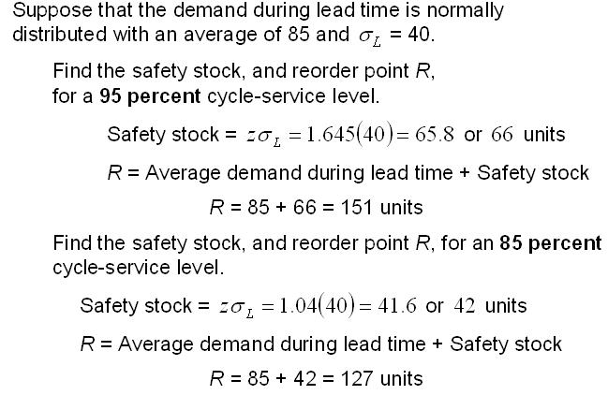
Application 12.4

Slide 41
Development of Demand Distributions for the Lead Time
σ_{t} = 15
σ_{t} = 15
σ_{t} = 15
+
+
=
75
Demand for week 1
75
Demand for week 2
75
Demand for week 3
σ_{t} = 26
225
Demand for 3-week lead time

Slide 42
Finding Safety Stock and R
Example 12.6
Suppose that the average demand for bird feeders is 18 units per week with a standard deviation of 5 units. The lead time is constant at 2 weeks. Determine the safety stock and reorder point for a 90 percent cycle-service level. What is the total cost of the Q system? (t = 1 week; d = 18 units per week; L = 2 weeks)
Demand distribution for lead time must be developed:
σ_{L} = σ_{t} L = 5 2 = 7.1
Safety stock = zσ_{L} = 1.28(7.1) = 9.1 or 9 units
Reorder point = dL + safety stock = 2(18) + 9 = 45 units
75
2
936
75
C = ($15) + ($45) + 9($15)
C = $562.50 + $561.60 + $135 = $1259.10

Slide 43
Selecting Reorder Point
When Demand & Lead Time Are Uncertain
PROBABILITY DISTRIBUTION FOR LEAD TIME
Lead Time (weeks) Probability for Lead Time
1 0.05
2 0.25
3 0.40
4 0.25
5 0.05
PROBABILITY DISTRIBUTION FOR DEMAND
Demand (units per week) Probability of Demand
24 0.15
28 0.20
32 0.30
36 0.20
40 0.15

Slide 44
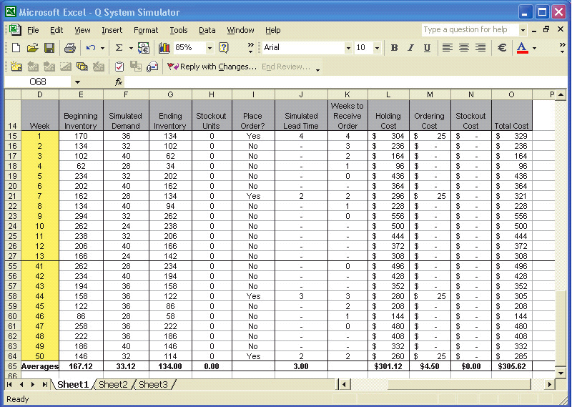
Simulating Demand (Solved Problem 8)
© 2007 Pearson Education

Slide 45
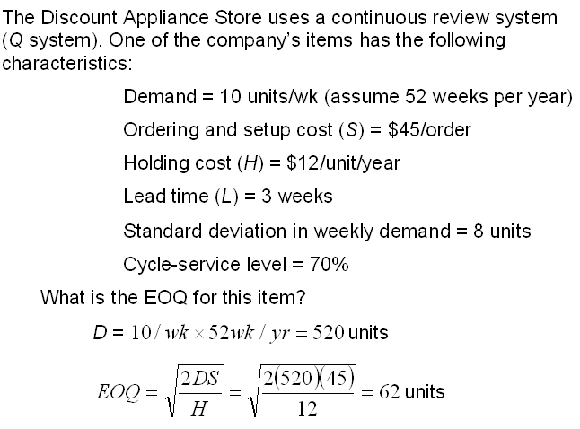
Application 12.5
Putting it all together for a Q System

Slide 46
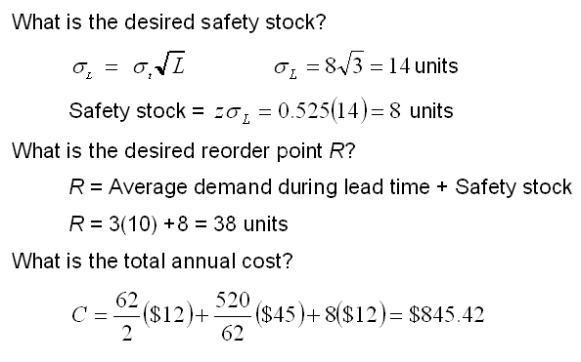
Application 12.5
Putting it all together for a Q System

Slide 47
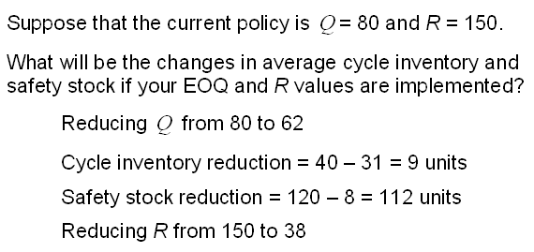
Application 12.5
Putting it all together for a Q System

Slide 48
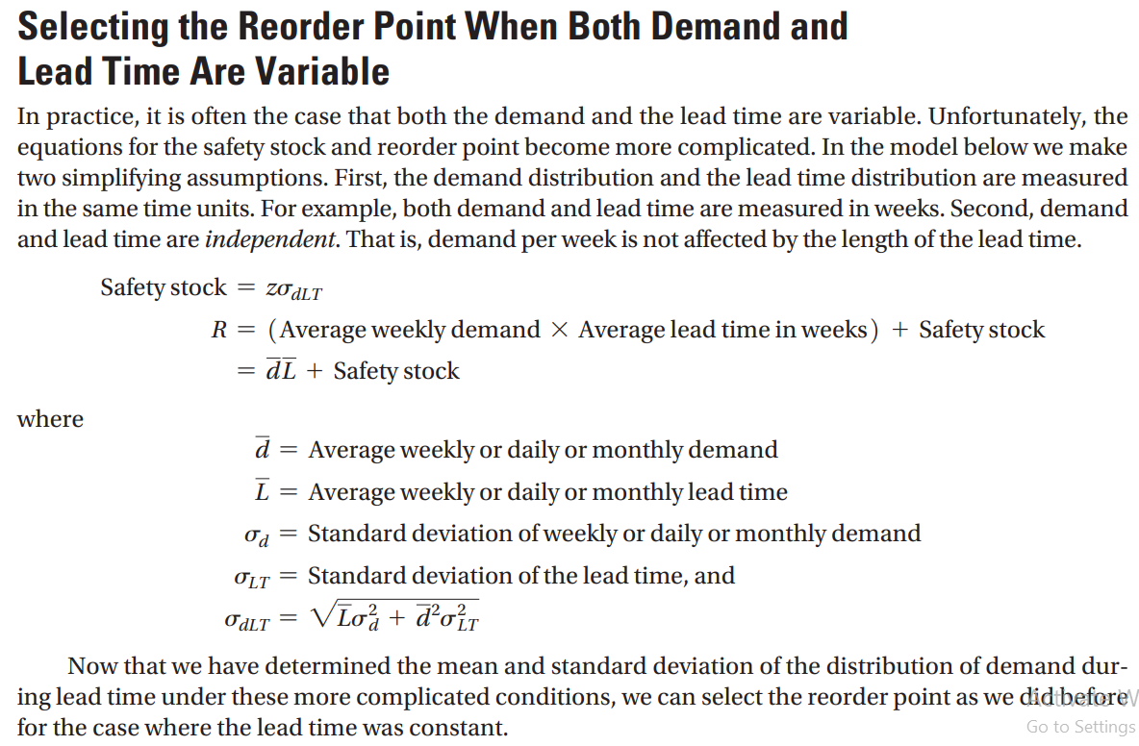


Slide 49
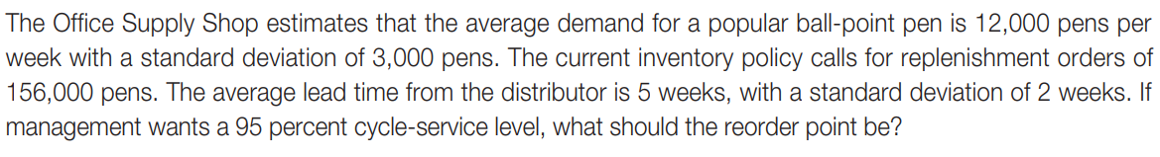
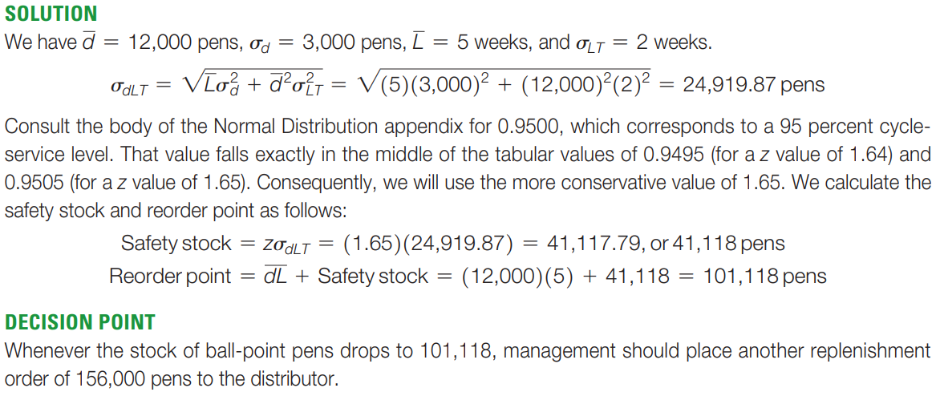
Example

Slide 50
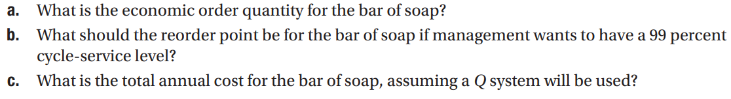
Practice Problem
Grey Wolf Lodge is a popular 500-room hotel in the North Woods. Managers need to keep close tabs on all room service items, including a special pine-scented bar soap. The daily demand for the soap is 275 bars, with a standard deviation of 30 bars. Ordering cost is $10 and the inventory holding cost is $0.30/bar/year. The lead time from the supplier is 5 days, with a standard deviation of 1 day. The lodge is open 365 days a year

Slide 51
Approaches for
Inventory Record Accuracy
Assign responsibility for reporting inventory transactions to specific employees.
Secure inventory in locked storage areas.
Cycle counting, an inventory control method, whereby storeroom personnel physically count a small percentage of the total number of items each day, correcting errors that they find, is used to frequently check records against physical inventory.
Logic error checks on each transaction; reporting and fully investigating discrepancies.
If inventory records prove to be accurate over several years’ time, the annual physical count can be avoided. It is disruptive, adds no value to the products, and often introduces as many errors as it removes.

Slide 52
Solved Problem 1
A distribution center’s average weekly demand is 50 units for an item valued at $650 per unit. Shipments from the warehouse average 350 units. Average lead time (including ordering delays and transit time) is 2 weeks. The distribution center operates 52 weeks per year & carries a 1-week supply as safety stock and no anticipation inventory. What is the average aggregate inventory being held by the distribution center?

Slide 53
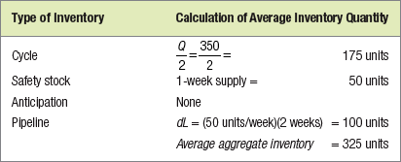
Solution

Slide 54
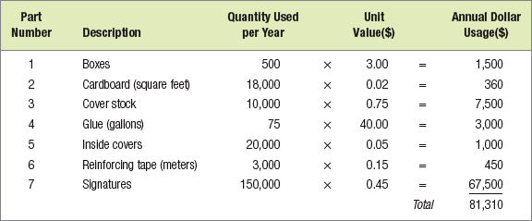
Solved Problem 2
Booker’s Book Bindery divides inventory items into 3 classes, according to their dollar usage. Calculate the usage values of the following inventory items and determine which is most likely to be classified as an A item.

Slide 55
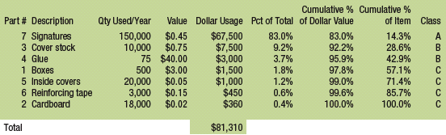
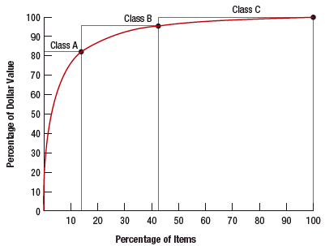
Solved Problem 2 continued
© 2007 Pearson Education

Slide 56
Solved Problem 3
EOQ, is 75 units when annual demand, D, is 936 units/year, setup cost, S, is $45, and holding cost, H, is $15/unit/year. If we mistakenly estimate inventory holding cost to be $30/unit/year, what is the new order quantity, Q, if D = 936 units/year, S = $45, and H = $30/unit/year? What is the change in order quantity, expressed as a percentage of the EOQ (75 units)?

Slide 57


Solution
The new order quantity is
The change in percentage is

Slide 58
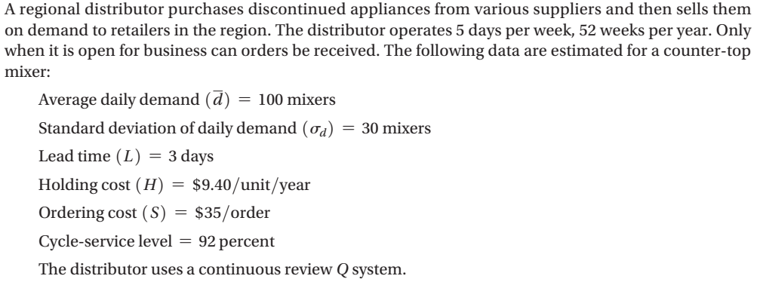
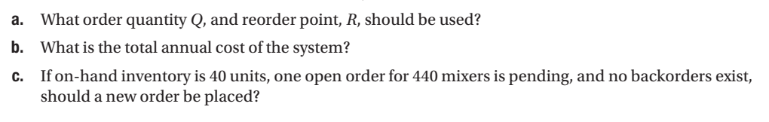
Problem 4

Slide 59
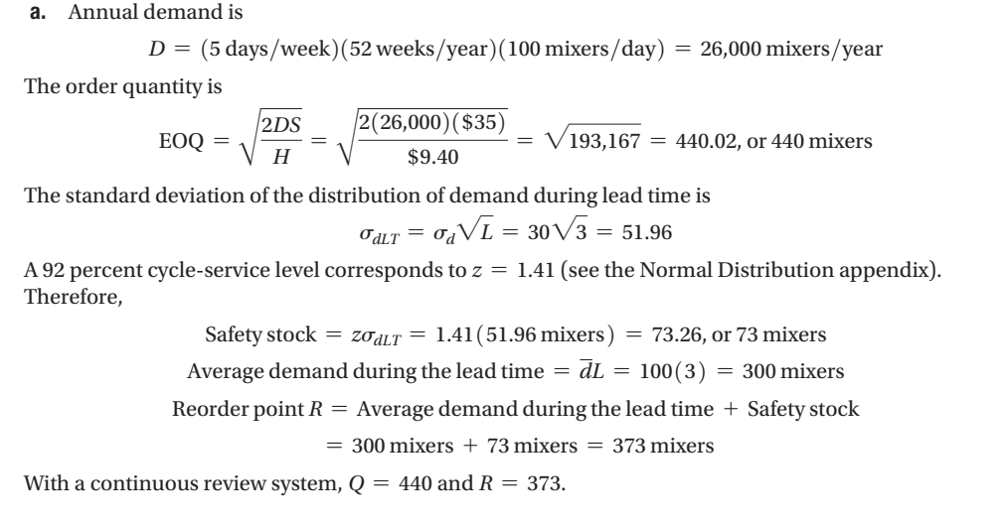
Solution

Slide 60
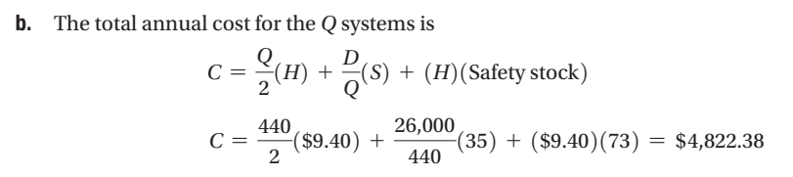
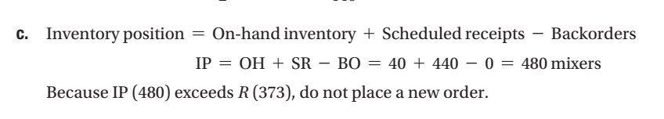
Solution

